Slide 1

IMPLEMENTAREA CONCURENTEI IN LIMBAJE DE PROGRAMARE
Ioana Leustean
INTRODUCERE IN
ERLANG
http://www.erlang.org/

Slide 2
PARALELISM CONCURENTA SISTEME DISTRIBUITE
"Erlang was designed from the bottom up to program concurrent, distributed,
fault-tolerant, scalable, soft, real-time systems. […]
If your problem is concurrent, if you are building a multiuser system, or if
you are building a system that evolves with time, then using Erlang might
save you a lot of work, since Erlang was explicitly designed for building such
systems. […]
Processes interact by one method, and one method only, by exchanging
messages. Processes share no data with other processes. This is the reason
why we can easily distribute Erlang programs over multicores or networks. "
Joe Armstrong, Programming Erlang, Second Edition 2013

Slide 3
Bibliografie
Joe Armstrong, Robert Virding, Mike Williams, Concurrent Programming in Erlang, 1993
Joe Armstrong, Programming Erlang, Second Edition 2013
Fred Hébert, Learn You Some Erlang For Great Good, 2013
https://www.erlang.org/doc/

Slide 4
Erlang este dezvoltat de Ericsson (initial in 1986)
Creatorii: Joe Armstrong, Robert Virding, and Mike Williams
Erlang este un limbaj functional
Nu are variabile mutabile.
Are functii de nivel inalt.
Sistemul tipurilor este dinamic, verificarea corectitudinii se face la rulare.
Codul este compilat si rulat pe o masina virtuala numita BEAM.
Erlang/OTP (Open Telecom Platform)
OTP este o multime de librarii si tool-uri folosite pentru a crea aplicatii distribuite
Numele vine de la
Agner Krarup Erlang (1878-1929) matematician si inginer danez
Ericsson Language

Slide 5
Limbajul Erlang - introducere

Slide 6
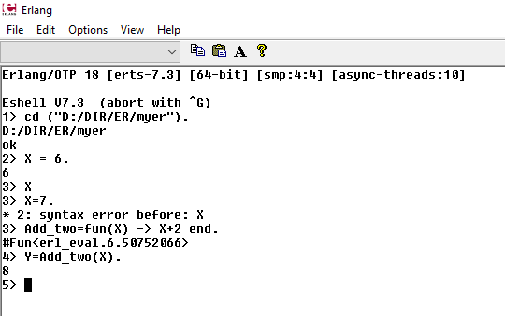
erl / werl
http://erlang.org/doc/man/shell.html
werl
erl
f()
elimina legaturile variabilelor
http://erlang.org/doc/man/shell.html

Slide 7
Erlang
comentariile incep cu %
% comentariu pe o linie
variabilele incep cu litera mare sau _ (celelalte caractere sunt alfanumerice, @,_)
atomii incep cu litera mica; numele functiilor sunt atomi
termen = data de orice tip
orice instructiune se termina cu punct .
un program este format din module;
numele fisierului coincide cu numele modulului si are extensia .erl;
compilarea se face folosind comanda c(nume_fisier)

Slide 8
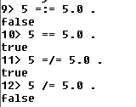
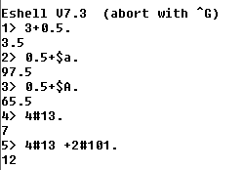
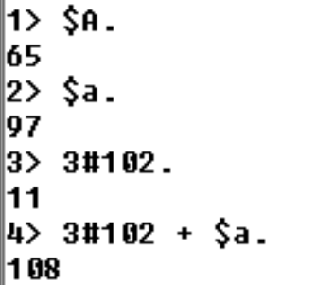
Tipuri de date
Number:
Integer
$char % codul ASCII
base#integer
Floats
== face conversie explicita
pentru numere
http://erlang.org/doc/reference_manual/data_types.html

Slide 9
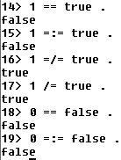
Tipuri de date
Boolean
orelse/andalso
Expr1 orelse Expr2
Expr1 andalso Expr2
al doilea argument este
evaluat numai la nevoie
Atoms (named symbolic constants)
luni, 'Luni', 'Prima zi'
http://erlang.org/doc/reference_manual/data_types.html

Slide 10
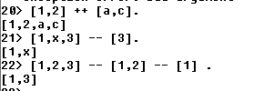
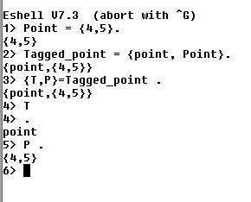
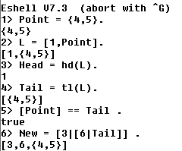
Tipuri de date
Liste
Tupluri
--, ++ right-associative
| este constructor
[1,2,a,c]
listele pot avea elemente de tipuri diferite

Slide 11
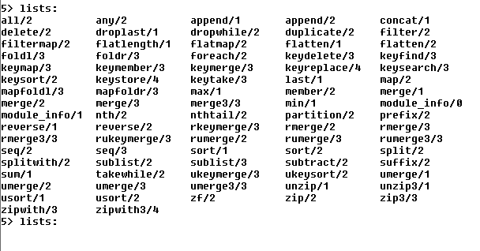


Continutul modulului lists
werl
tab
http://erlang.org/doc/man/lists.html

Slide 12
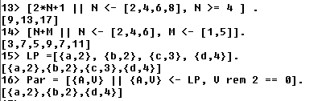

Tipuri de date
Liste: definirea listelor prin comprehensiune
String: "hello" (notatii pentru lista codurilor ASCII)
Nu exista un tip char.
Caracterele sunt reprezentate prin codurile ASCII
http://erlang.org/doc/reference_manual/data_types.html

Slide 13
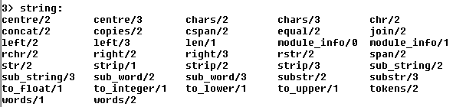
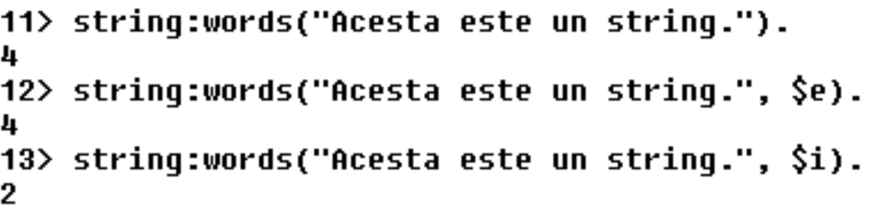
Continutul modulului string:
words/1 , words/2
doua functii diferite pot avea acelasi nume
daca au un numar diferit de argumente
http://erlang.org/doc/man/string.html
modul:functie(argumente).

Slide 14
Conversii explicite:
Type-tests:
1> atom_to_list(hello).
"hello"
2> list_to_atom("hello").
Hello
3> float_to_list(7.0).
"7.00000000000000000000e+00"
4> list_to_float("7.000e+00").
7.0
5> integer_to_list(77).
"77"
6> list_to_integer("77").
77
7> tuple_to_list({a,b,c}).
[a,b,c]
8> list_to_tuple([a,b,c]).
{a,b,c}
http://erlang.org/doc/reference_manual/data_types.html

Slide 15
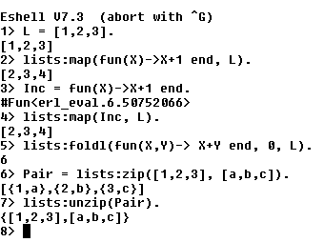
Functii de nivel inalt
Atentie!
map, zip, foldl
se gasesc in modulul lists
http://erlang.org/doc/programming_examples/funs.html

Slide 16
Functii de nivel inalt
http://erlang.org/doc/programming_examples/funs.html

Slide 17
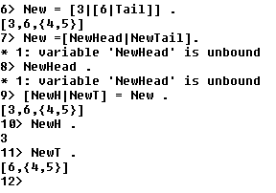
Pattern matching
pattern = termen
In termen toate variabilele sunt legate
Un pattern este ca un termen in care
sunt si variabile libere

Slide 18
Module
-module(mymod).
-export([hello/2,factorial/1, start/0]).
hello(S,X) -> io:format("Hello ~s, factorialul este ~p!~n",[S,X]).
factorial(0) -> 1;
factorial(N) -> N * factorial(N-1).
start() ->
{ok,[Name]}= io:fread("Your Name:", "~s"),
{ok,[Val]}= io:fread("Your No:", "~d"),
hello(Name, factorial(Val)).
atribute
declaratii de functii
http://erlang.org/doc/reference_manual/modules.html

Slide 19
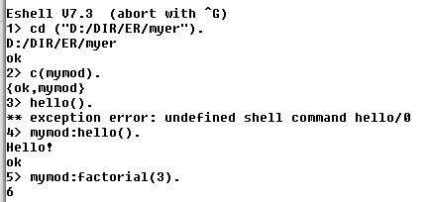
Module
mymod.erl
numele fisierului coincide cu numele modulului
-module(mymod). %attribute
-export([hello/0,factorial/1]). %attribute
% -compile(export_all).
hello() -> io:format("Hello!~n"). %function
factorial(0) -> 1; %function
factorial(N) -> N * factorial(N-1).
modul:functie(argumente)
o functie e unic determinate de
(modul, nume, aritate)

Slide 20

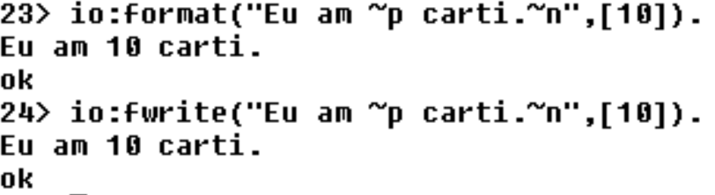
Module
mymod.erl
-module(mymod). %attribute
-export([hello/0,factorial/1]). %attribute
-define(Eu, "Ioana") %macros
hello() -> io:format("Hello, ~s!~n",[?Eu]). %function
io:format/io:fwrite sunt echivalente
https://www.erlang.org/docs/28/apps/stdlib/io.html

Slide 21
Definirea functiilor
se face folosind pattern-uri
prels("a"++ L) -> io:format("~s ~n",[L++L]);
prels("b"++ L) -> io:format("~s ~n",[L++"b"]);
prels(_) -> io:format("Nu incepe cu \"a\" sau \"b\". ~n").
clauza
clauza
clauza
clauza

Slide 22
Definirea functiilor
O declaratie de functie este o secventa de clauze separate prin ; care se termina cu .
Name(Pattern11,...,Pattern1N) [when GuardSeq1] ->
Body1;
...;
Name(PatternK1,...,PatternKN) [when GuardSeqK] ->
BodyK.
Body
Expr1,
...,
ExprN
Corpul unei clause este o secventa de expresii separate prin ,
http://erlang.org/doc/reference_manual/functions.html
Valoarea returnata este valoarea ultimei expresii

Slide 23
Definirea functiilor folosind garzi (when)
par(X) -> (X rem 2 == 0) .
preln(X) when par(X) -> io:format("Este par ~n"); %gresit
nu se accepta functii definite de utilizator in garzi
Corect!
prelg(X) when (X rem 2 == 0) -> io:format("Este par ~n");
prelg(_) -> io:format("Este impar ~n").

Slide 24
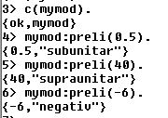
Definirea functiilor
if .. end
preli(X) ->
Rez = if ((X =< 1) and (X >= 0)) -> "subunitar";
(X > 1) -> "supraunitar";
true -> "negativ"
end,
{X,Rez}.
obligatorie
case .. end
prelc({S,X}) -> case {S,X} of
{"pozitiv", X} when ((X =< 1) and (X >= 0)) -> "subunitar";
{"pozitiv",X} when (X>1) -> "supraunitar";
{_,X} when (X >= 0) -> "pozitiv";
_ -> "negativ"
end.

Slide 25
Definirea functiilor
functii anonime
Add_two = fun(X) -> X+2 end.

Slide 26
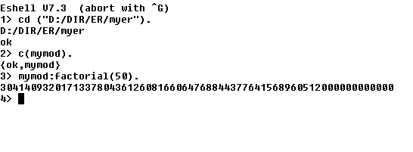


Slide 27
myfact.erl
-module(myfact).
-export([run/0]).
factorial(0) -> 1;
factorial(N) -> N * factorial(N-1).
hello(S,X) -> io:format("Hello ~s, factorialul este ~p!~n",[S,X]).
run() ->
{ok,[Name]}= io:fread("Your Name:", "~s"),
{ok,[Val]}= io:fread("Your Number:", "~d"),
hello(Name, factorial(Val)).

Slide 28
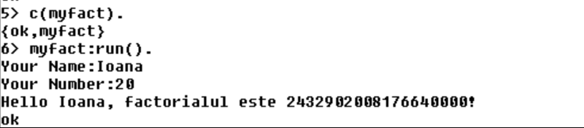
myfact.erl
-module(myfact).
-export([run/0]).
factorial(0) -> 1;
factorial(N) -> N * factorial(N-1).
hello(S,X) -> io:format("Hello ~s, factorialul este ~p!~n",[S,X]).
run() ->
{ok,[Name]}= io:fread("Your Name:", "~s"),
{ok,[Val]}= io:fread("Your Number:", "~d"),
hello(Name, factorial(Val)).

Slide 29
Erlang-99: 99 Erlang Problems
https://purijatin.github.io/newsletters/erlang-99/

Slide 30
Concurenta in Erlang
Jim Larson, Erlang for Concurrent Programming, ACM Queue, 2008

Slide 31
CONCURRENCY IN ERLANG
lightweight processes with
asynchronous message passing
Procesele in Erlang:
pot fi create si distruse rapid
comunica prin mesaje, iar comunicarea este rapida
sunt complet independente din punctul de vedere al memoriei

Slide 32
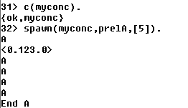
Crearea proceselor: spawn
Functia spawn creaza un process care este executat in parallel cu procesul care l-a creat si
intoarce un Pid (Process Identifier) , care este folosit pentru trimiterea mesajelor.
spawn/3
spawn(modul, functie, lista argumentelor)
Pid = spawn(modul, functie, lista argumentelor)
-module(myconc).
-export([prelA/1).
prelA(X) when (X == 0) -> io:format("End A ~n");
prelA(X) when (X > 0) -> io:format("A ~n"), prelA(X-1);
prelA(_) -> io:format("error ~n").
Pid= spawn(myconc,prelA,[5]).

Slide 33
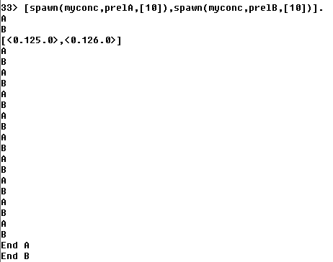
Exemplu: doua procese care sunt executate in paralel
Un proces este identificat printr-un
"process identifier (pid)".
Un pid este un tip de date in Erlang
https://www.erlang.org/doc/reference_manual/data_types.html#pid
In interiorul unui proces, functia self()
intoarce pid-ul procesului.
In Erlang, shell-ul este un proces.
interleaving
executie paralela

Slide 34
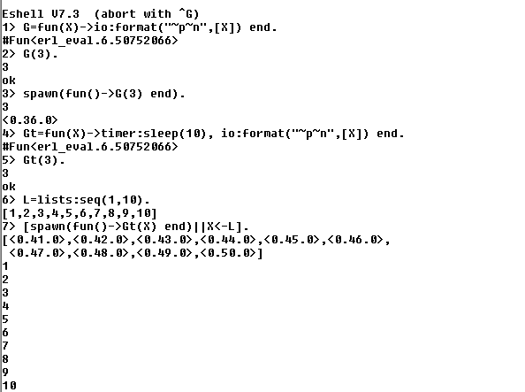
timer:sleep(10)
suspenda procesul pentru
10 milisecunde
http://erlang.org/doc/man/timer.html
spawn/1
spawn (fun() -> Gt(X) end )
Argumentul lui spawn este o functie, nu un apel de functie.

Slide 35
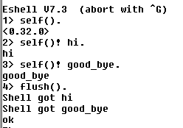
Trimiterea mesajelor: Pid ! msg
Mesajul msg este trimis procesului cu id-ul Pid. Mesajul este un termen Erlang.
flush()
elimina mesajele trimise shell-ului

Slide 36
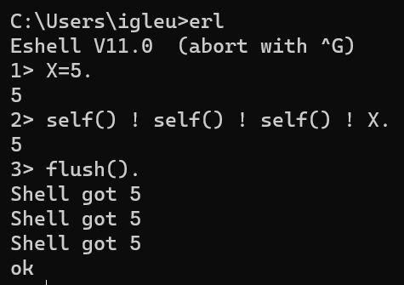
Trimiterea mesajelor: Pid ! msg
Mesajul msg este trimis procesului cu id-ul Pid. Mesajul este un termen Erlang.
Pid1 ! Pid2 ! ! Pidn ! msg
msg este evaluat

Slide 37
Primirea mesajelor
Mesajul msg este trimis procesului cu id-ul Pid. Mesajul este un termen Erlang.
procesul Rec primeste mesajul {do_A, 2}
myrec() ->
receive
{do_A, X} -> prelA(X);
{do_B, X} -> prelB(X);
_ -> io:format("Nothing to do ~n")
end.
raspunsul este definit
in instructiunea
receive … end

Slide 38
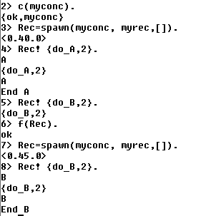
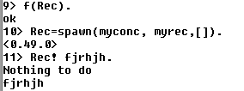
Primirea mesajelor
Mesajul msg este trimis procesului cu id-ul Pid. Mesajul este un termen Erlang.
myrec() ->
receive
{do_A, X} -> prelA(X);
{do_B, X} -> prelB(X);
_ -> io:format("Nothing to do ~n")
end.

Slide 39
receive … end
receive
Pattern1 when Guard1 -> Expr1;
Pattern2 when Guard2 -> Expr2;
Pattern3 -> Expr3
end
Cand ajunge la o instructiune receive un proces
scoate un mesaj din coada de mesaje si incearca sa
ii gaseasca un sablon.
Daca coada de mesaje este vida procesul se
blocheaza si asteapta un mesaj care se potriveste
cu un sablon.
trimiterea mesajelor se face asincron
receive este singura instructiune care blocheaza procesul

Slide 40
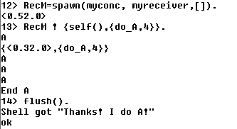
Schimb de mesaje intre procese
myreceiver() ->
receive
{From, {do_A, X}} -> From ! "Thanks! I do A!",
prelA(X);
{From, {do_B, X}} -> From! "Thanks! I do B!",
prelB(X);
_ -> io:format("Nothing to do ~n")
end.
schimb de mesaje intre
Rec si shell

Slide 41
"Messages between Erlang processes are simply valid Erlang terms. That is, they can be lists, tuples, integers, atoms, pids, and so on.
Each process has its own input queue for messages it receives. New messages received are put at the end of the queue. When a process executes a receive, the first message in the queue is matched against the first pattern in the receive. If this matches, the message is removed from the queue and the actions corresponding to the pattern are executed.
However, if the first pattern does not match, the second pattern is tested. If this matches, the message is removed from the queue and the actions corresponding to the second pattern are executed. If the second pattern does not match, the third is tried and so on until there are no more patterns to test. If there are no more patterns to test, the first message is kept in the queue and the second message is tried instead. If this matches any pattern, the appropriate actions are executed and the second message is removed from the queue (keeping the first message and any other messages in the queue). If the second message does not match, the third message is tried, and so on, until the end of the queue is reached. If the end of the queue is reached, the process blocks (stops execution) and waits until a new message is received and this procedure is repeated."
http://erlang.org/doc/getting_started/conc_prog.html

Slide 42
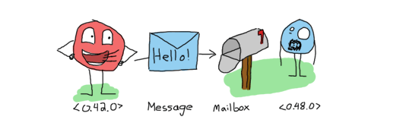
Transmiterea mesajelor este asincrona.
Datorita cozii pentru mesaje,
procesul care transmite mesajul
nu asteapta o confirmare de primire sau
prelucrarea acestuia,
mesajul intra in coada si asteapta
pana cand va fi procesat
http://learnyousomeerlang.com/the-hitchhikers-guide-to-concurrency#dont-panic

Slide 43
Concurenta in Erlang este implementata folosind urmatoarele primitive:
Pid = spawn (fun)
Pid = spawn (module, fct, args)
Pid ! Message
receive … end
https://www.erlang.org/doc/man/erlang.html#spawn-4

Slide 44
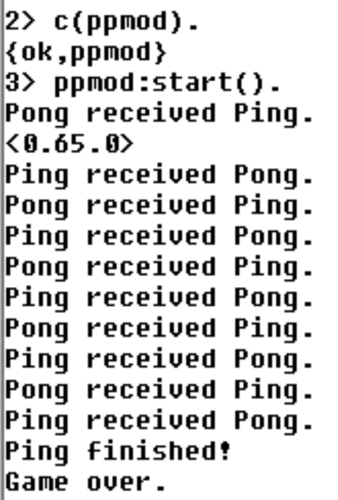
Ping - Pong
Exista doua procese: Ping si Pong
Procesul Ping trimite mesajul "Ping" si
asteapta sa primeasca mesajul "Pong"
Procesul Pong asteapta sa primeasca mesajul "Ping" si
trimite mesajul "Pong"
Procesul Pong este creat primul
http://erlang.org/doc/getting_started/conc_prog.html

Slide 45
Ping - Pong
pong() ->
receive
{_,finished} -> io:format("Game over. ~n");
{Pid, ping} -> io:format("Pong received Ping. ~n"),
Pid ! {self(),pong},
pong()
end.
ppmod.erl
-module(ppmod).
-export([start/0,pingN/2,pong/0]).
pingN(Pid,0) -> Pid ! {self(), finished},
io:format("Ping finished!~n");
pingN(Pid, N) -> Pid ! {self(),ping},
receive
{Pid, pong} -> io:format("Ping received Pong. ~n")
end,
pingN(Pid,N-1).
start() -> PongId = spawn(ppmod, pong,[]),
spawn(ppmod,pingN,[PongId,5]).
http://erlang.org/doc/getting_started/conc_prog.html

Slide 46
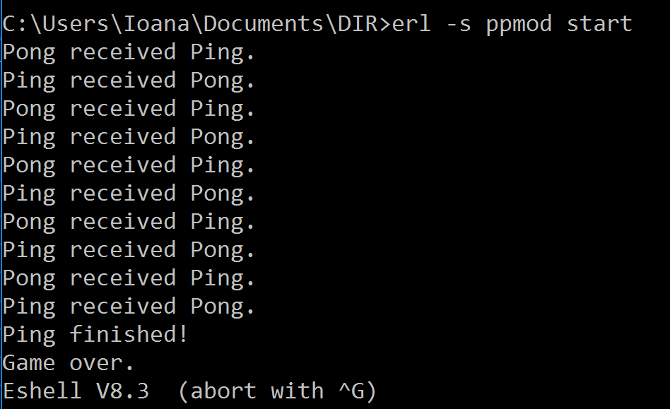
> erl –s ppmod start

Slide 47

ACTOR MODEL
"Erlang's actor model can be imagined as a world where everyone is sitting alone in their own room and can perform a few distinct tasks. Everyone communicates strictly by writing letters and that's it. While it sounds like a boring life (and a new age for the postal service), it means you can ask many people to perform very specific tasks for you, and none of them will ever do something wrong or make mistakes which will have repercussions on the work of others; they may not even know the existence of people other than you (and that's great).
To escape this analogy, Erlang forces you to write actors (processes) that will share no information with other bits of code unless they pass messages to each other. Every communication is explicit, traceable and safe."
Varianta online
Fred Hébert, Learn You Some Erlang For Great Good
http://learnyousomeerlang.com/introduction#what-is-erlang

Slide 48
Modelul Actori
Introdus de Carl Hewitt in 1973
Actorii sunt o notiune abstracta (corespunzatoare proceselor)
Actorii au memorie proprie, NU au memorie partajata
Actorii comunica prin mesaje
Un actor este capabil sa:
trimita mesaje actorilor pe care ii cunoaste
creeze noi actori
raspunda mesajelor pe care le primeste
Mesajele contin un destinatar si un continut
Trimiterea mesajelor este asincrona

Slide 49
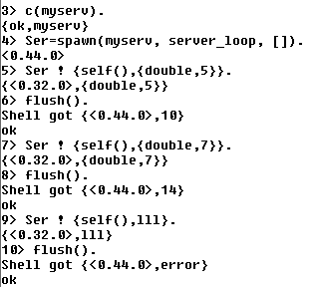
Cilent-Server (Exemplu simplu: doubling service)
Procesul Ser este serverul si
executa functia server_loop
Serverul primeste mesaje de la procese client si executa o actiune (dubleaza valoarea primita)
In acest exemplu singurul client este shell-ul
Mesajele primite de shell, adica raspunsurile trimise de server, sunt vizualizate cu flush()

Slide 50
Cilent-Server (Exemplu simplu: doubling service)
-module(myserv).
-export([server_loop/0]).
server_loop() ->
receive
{From, {double, Number}} -> From ! {self(),Number*2},
server_loop() ;
{From,_} -> From ! {self(),error},
server_loop()
end.

Slide 51
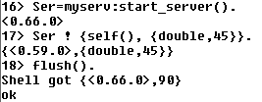
Cilent-Server : functie pentru pornirea server-ului
-module(myserv).
-export([server_loop/0]).
server_loop() ->
receive
{From, {double, Number}} -> From ! {self(), Number*2},
server_loop() ;
{From,_} -> From ! {self(),error},
server_loop()
end.
-export([start_server/0, server_loop/0]).
start_server() -> spawn(myserv, server_loop, []).

Slide 52
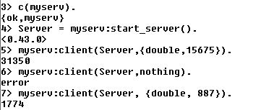
Cilent-Server: functia client
client(Pid, Request) ->
Pid ! {self(), Request},
receive
{Pid, Response} -> Response
end.
-module(myserv).
-export([start_server/0, server_loop/0,client/2]).
start_server() -> spawn(myserv, server_loop, []).
server_loop() ->
receive
{From, {double, Number}} -> From ! {self(),(Number*2)},
server_loop() ;
{From,_} -> From ! {self(),error},
server_loop()
end.
functia client intoarce raspunsul primit de la server
apelarea functiei client

Slide 53
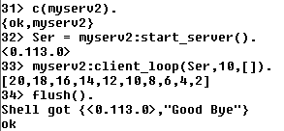
Client-Server
client_loop creaza mai multe procese client si intoarce lista rezultatelor
client_loop(Pid,0,L) -> Pid! {self(),"Good Bye"},
L;
client_loop(Pid, X, L) -> R= client(Pid,{double,X}),
client_loop(Pid, X-1, L++[R]).

Slide 54
Client-Server
client_loop creaza mai multi clienti si intoarce lista rezultatelor
client_loop(Pid,0,L) -> Pid! {self(),"Good Bye"},
L;
client_loop(Pid, X, L) -> R= client(Pid,{double,X}),
client_loop(Pid, X-1, L++[R]).
Functiile client sunt executate secvential!

Slide 55
Client-Server
client_loop creaza mai multi clienti si intoarce lista rezultatelor
client_loop(Pid,0,L) -> Pid! {self(),"Good Bye"},
L;
client_loop(Pid, X, L) -> R= client(Pid,{double,X}),
io:fwrite("prel ~w!~n", [X]),
client_loop(Pid, X-1, L++[R]).
Functiile client sunt executate secvential!

Slide 56
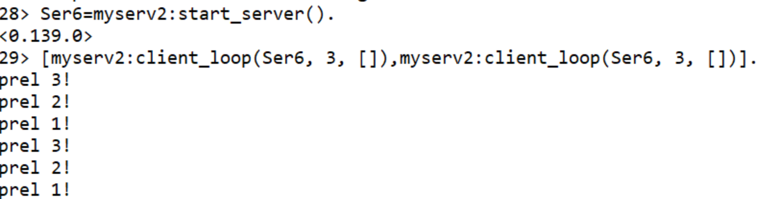
Client-Server
client_loop creaza mai multi clienti si intoarce lista rezultatelor
client_loop(Pid,0,L) -> Pid! {self(),"Good Bye"},
L;
client_loop(Pid, X, L) -> R= client(Pid,{double,X}),
io:fwrite("prel ~w!~n", [X]),
client_loop(Pid, X-1, L++[R]).
Functiile client sunt executate secvential!

Slide 57
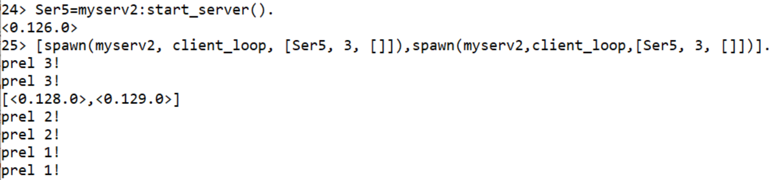
Client-Server
client_loop creaza mai multi clienti si intoarce lista rezultatelor
client_loop(Pid,0,L) -> Pid! {self(),"Good Bye"},
L;
client_loop(Pid, X, L) -> R= client(Pid,{double,X}),
io:fwrite("prel ~w!~n", [X]), client_loop(Pid, X-1, L++[R]).
Functiile client sunt executate in paralel!

Slide 58
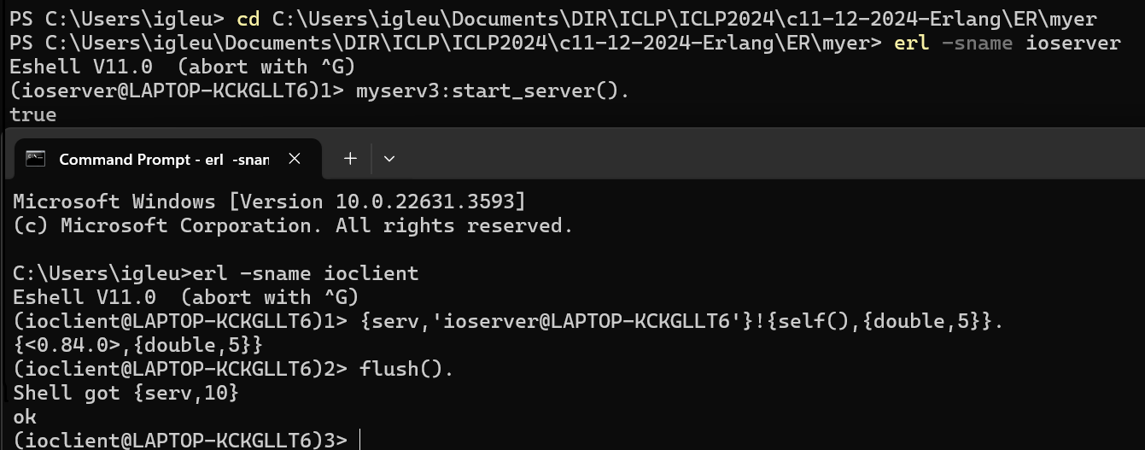

Distributed Erlang: programele ruleaza in noduri diferite
Crearea unui nod in Erlang
>erl –sname …
Numele e atom!

Slide 59
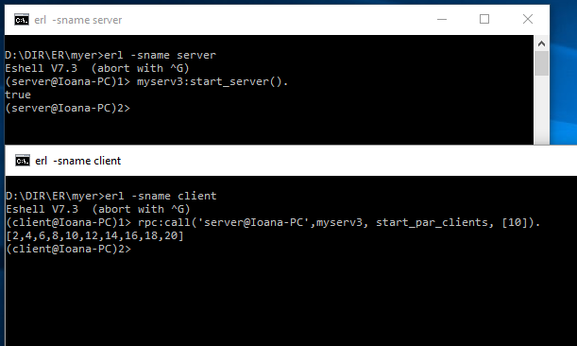
Distributed Erlang: programele ruleaza in noduri diferite
Crearea unui nod in Erlang
>erl –sname …
rpc:call
remote procedure call
http://erlang.org/doc/man/rpc.html#call-4

Slide 60
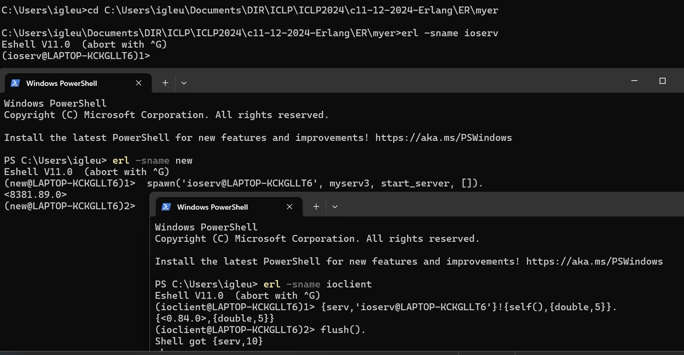
Distributed Erlang: programele ruleaza in noduri diferite
cu spawn/4 serverul este pornit din alt nod
https://www.erlang.org/doc/apps/erts/erlang#spawn/4

